Slide 1

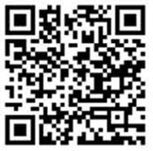
In 2026 the Society of British Neurological Surgeons will be marking its Centenary with a conference to celebrate all that has been achieved in neurosurgery, in the UK and Ireland over the past 100 years.
We would like to extend a warm invitation to our fellow neuroscience colleagues from around the world, including colleagues who have worked or trained in the UK.
If you would like to receive further information about the event, please scan the QR code and subscribe to our mailing list or visit the conference webpage
https://www.sbns.org.uk/event-calendar/sbns-100.html

Slide 2
If you would like to receive further information about the event, please scan the QR code and subscribe to our mailing list or visit the conference webpage
https://www.sbns.org.uk/event-calendar/sbns-100.html

Slide 3


